Slide 1

REALESTATE PREDICTOR: AI-DRIVEN REAL-TIME PROPERTY VALUATION
VALLURU MOHAMMAD RASHEED
--20BIT0216
GUIDE NAME: GUNDALA SWATHI MAM

Slide 2

Proposed methodlogy
I have used 6 various ml algorithms to check the best algorithm with respective to accuracy
Linear regression
Lasso regression
Ridge regression
Support vector machine
Random forest
XGBoost

Slide 3
1. Linear regression
This model builds links between the many variables being studied. Correlation coefficients or regression equations can be used to determine the correlation between variables. There are models that can identify the most important aspects for understanding the dependent variable. Multiple regression is used to collect data on both independent and dependent factors to anticipate certain prices. Multiple linear regression determines the link between dependent and independent variables.

Slide 4
2. Ridge Regression
This model builds if linear regression model becomes overfitted then we use this to increase the efficiency of the model. By using linear regression, we will find cost function it means we will subtract the actual value with the predicted value and squares the outcome. Main aim to build this model is to get the value as zero So, to get this we will add the multiple of alpha and square of the slope. This will increase the efficiency.

Slide 5
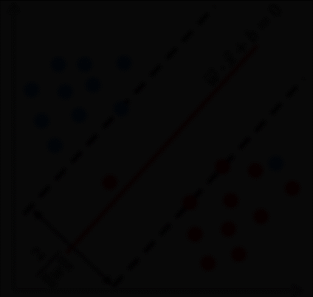
3. Lasso Regression
This model builds if linear regression model becomes overfitted then we use this to increase the efficiency of the model. By using linear regression, we will find cost function it means we will subtract the actual value with the predicted value and squares the outcome. Main aim to build this model is to get the value as zero So, to get this we will add the multiple of alpha and magnitude of the slope. This will increase the efficiency.

Slide 6
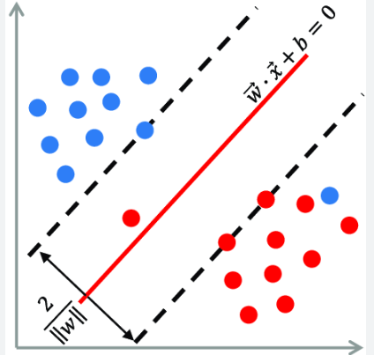
4. Linear support vector Regression
In SVM regression, the aim is to create a function f(x) that predicts the target variable y based on input characteristics. The hyperplane in SVM regression is defined as f(x)=⟨w,x⟩+b, where w represents the weight vector, x is the input feature vector, and b is the bias factor. The hyperplane aims to suit the data points as closely as possible while maximizing the margin.

Slide 7
5. Random forest
Random Forest regression is an ensemble learning approach that integrates the predictions of numerous decision trees to get a more accurate and stable result. During training, several decision trees are created from random subsets of the training data and features. Each tree is trained individually, and the final prediction is calculated by averaging the predictions of all individual trees (for regression tasks). This ensemble technique reduces overfitting and improves generalization performance. Furthermore, Random Forests incorporates unpredictability into the feature selection process, increasing the model's resilience and lowering the danger of overfitting.

Slide 8
5. XGBoost
Extreme Gradient Boosting (XGBoost) is a well-known and strong machine learning technique that excels in regression and classification problems. It is part of the gradient boosting method family, which iteratively creates an ensemble of weak learners to minimize a given loss function. XGBoost begins by fitting an initial decision tree to the data and then adds additional trees in a sequential order to rectify mistakes caused by earlier models. Each new tree is trained using the residuals.

Slide 9
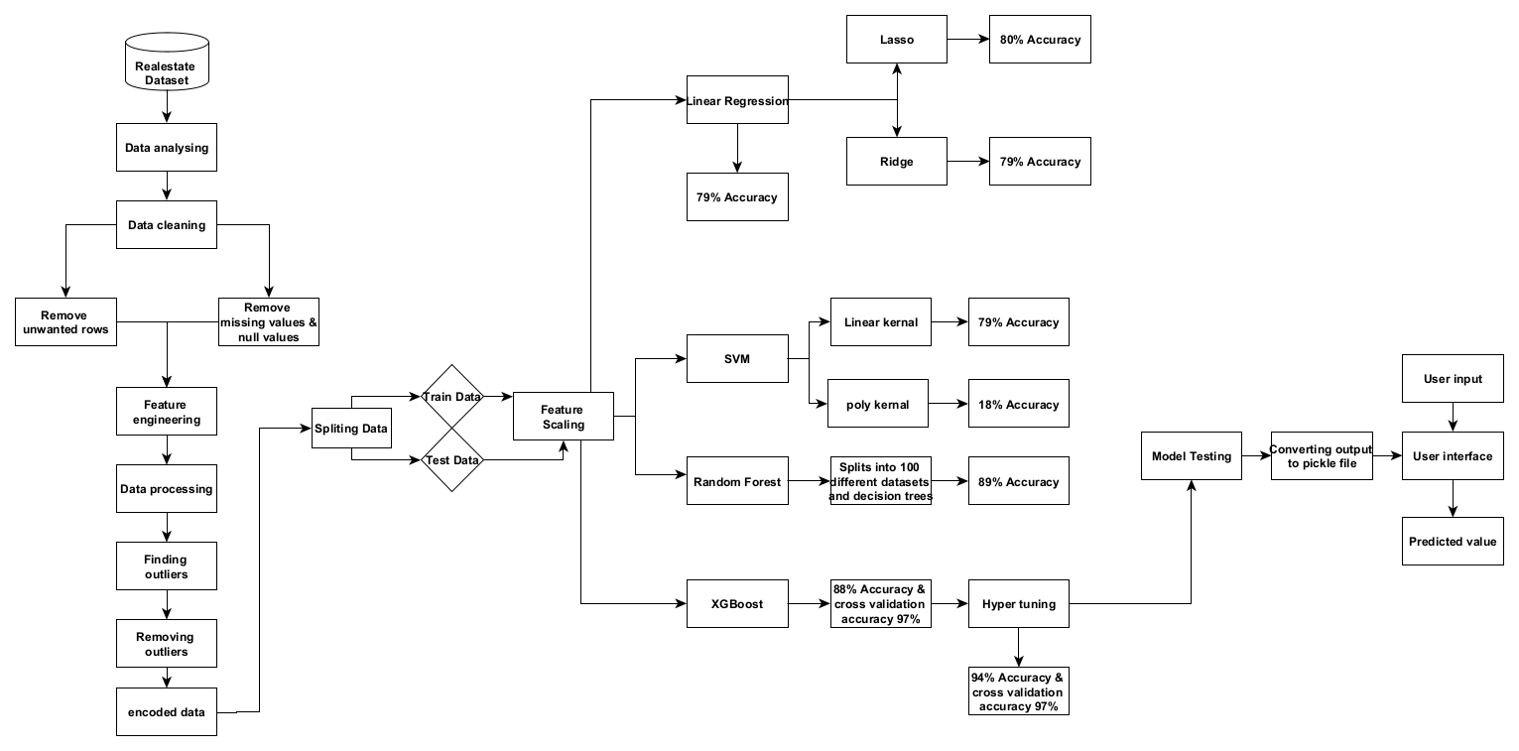
System Architecture

Slide 10

The architecture provides the complete process of the model from beginning to end. We start with the data collection and cleaning the data and removes the unwanted data from the data set. Now we need to preprocess the data. After that we need to find any outliers present in the data and remove it after completing all the transformations now, we need to train the model and test that model and after that we need to deploy it flask.

Slide 11

Module Description:
Data analysis: In this stage we need to check the data first and get detailed information about the data whether it is useful or not.
Data cleaning: In this stage we need to search for null values if u find any null values in any column with minimum % then drop that row from the table and if u got so many null values in the column, then u need to drop that column, if u don’t drop that column it leads to failure of our model. In my data society has 41.3% missing value so I have dropped that column

Slide 12
Module Description:
Data preprocessing: In this stage we need to convert the data into integer type by that we can easily train and test our regression model.
Feature scaling: we need to do feature scaling for the data because the values of the features is in different range. If it has different range, then it might have a chance of to reduce the working efficiency

Slide 13

Module Description:
Model training: In this stage I have used 6 models to compare the models which gives best accuracy. First, I have used linear regression in that I got an accuracy of 79% and rsme value of round 65-70% so it is overfitting. Then I used lasso, ridge and SVM too they also not gave much convenient outcome, so I used random forest and XGBoost models then I got some good accuracy. I used the XGBoost model to train and test the model.
Deployment: In this stage I build a front-end model to showcase the output with the help of flask to combine the web application and the model.

Slide 14

Libraries
Flask: A micro web framework for Python and used for building web applications, APIs, and web services
Pandas: A powerful data manipulation and analysis library used for data manipulation, including reading, and writing data from various file formats, data cleaning, reshaping, merging, slicing, and aggregating data.
Scikit-learn: A machine learning library for Python employed for implementing machine learning algorithms, including data preprocessing, model selection, training, evaluation, and deployment.

Slide 15
Libraries
Matplotlib: A plotting library for creating static, interactive, and animated visualizations in Python Utilized for creating static, interactive, and animated visualizations such as line plots, scatter plots, histograms, bar charts, pie charts, etc., to explore and communicate insights from data.
Seaborn: A data visualization library based on Matplotlib, providing a high-level interface for drawing attractive and informative statistical graphics.

Slide 16

Thank You

